Slide 1

ANÁLISIS GEOESPACIAL
EDIER V. ARISTIZÁBAL G.
Ing. Geólogo (Universidad Nacional de Colombia)
Esp. en Gestión de Riesgos Geológicos (Universidad de Ginebra – Suiza)
MSc. en Geociencias (Universidad de Shimane – Japón)
PhD. en Ingeniería (Universidad Nacional de Colombia)
Universidad Nacional de Colombia
Facultad de Minas
Departamento de Geociencias

Slide 2
All models are wrong, but some are useful.
George Box

Slide 3
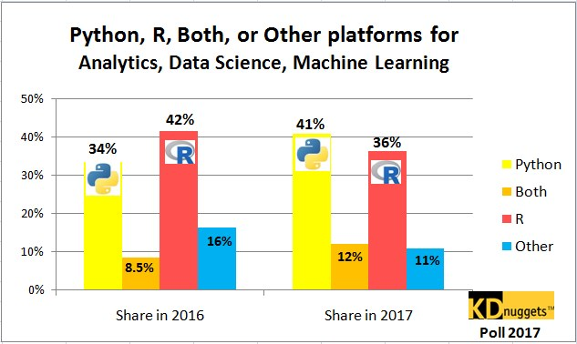

Slide 5
PYTHON
Python code is fast to develop: As the code is not required to be compiled and built, Python code can be much readily changed and executed. This makes for a fast development cycle.
Python code is not as fast in execution: Since the code is not directly compiled and executed and an additional layer of the Python virtual machine is responsible for execution, Python code runs a little slow as compared to conventional languages like C, C++, etc.
It’s interpreted: Many programming languages require that a program be converted from the source language, such as C++ or Visual Basic, into binary code that the computer can understand. This requires a compiler with various options. Python is an interpreted language, which means it does not need compilation to binary code before it can be run. You simply run the program directly from the source code, which makes Python easier to work with and much more portable than other programming languages.
It’s object oriented: Python is an object-oriented programming language. An object-oriented program involves a collection of interacting objects, as opposed to the conventional list of tasks. Many modern programming languages support object-oriented programming. ArcGIS is designed to work with object-oriented languages, and Python qualifies in this respect.

Slide 6
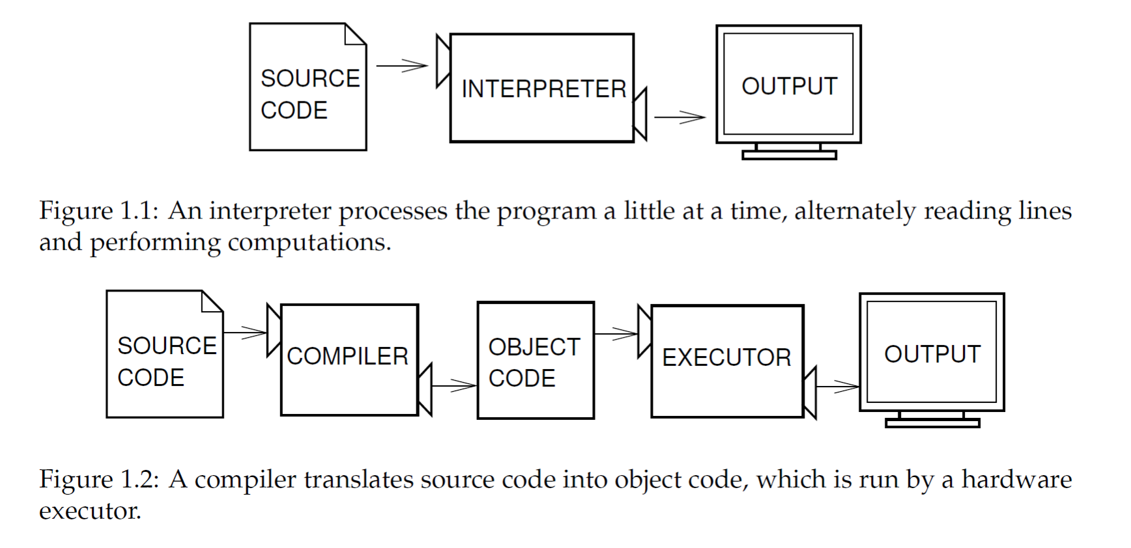
High-level languages into low-level languages:
Interpreters & Compilers
An interpreter reads a high-level program and executes it, meaning that it does what the program says. It processes the program a little at a time, alternately reading lines and performing computations.
A compiler reads the program and translates it completely before the program starts running.
In this context, the high-level program is called the source code, and the translated program is called the object code or the executable. Once a program is compiled, you can execute it repeatedly without further translation.

Slide 7
Scripting vs. Programming
Although Python is a programming language, it is often referred to as a scripting language.
A scripting language refers to automating certain functionality within another program, while a programming language involves the development of more sophisticated multifunctional applications.
Scripting is a programming task that allows you to connect diverse existing components to accomplish a new, related task. Scripting is the “glue” that allows you to put various existing elements together.

Slide 8
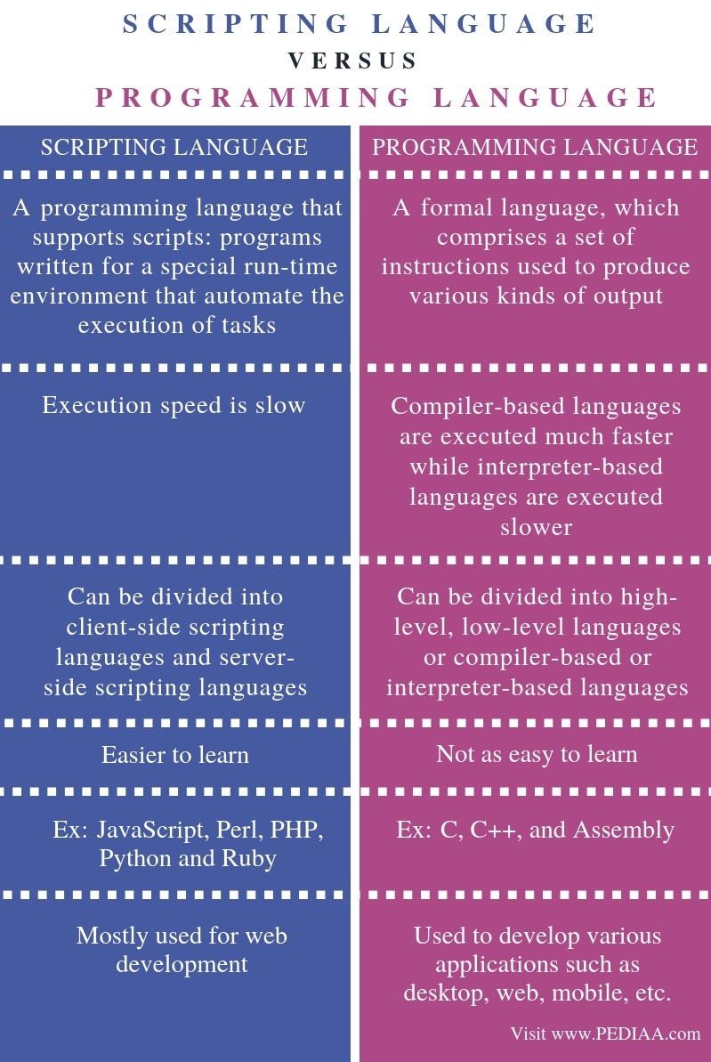

Slide 9
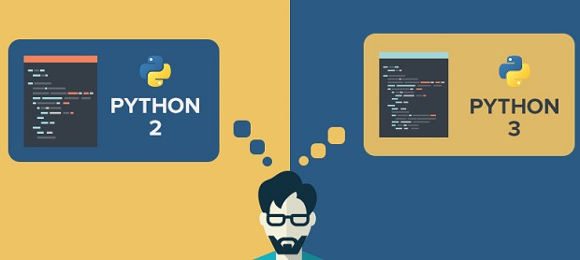
https://wiki.python.org/moin/Python2orPython3

Slide 10
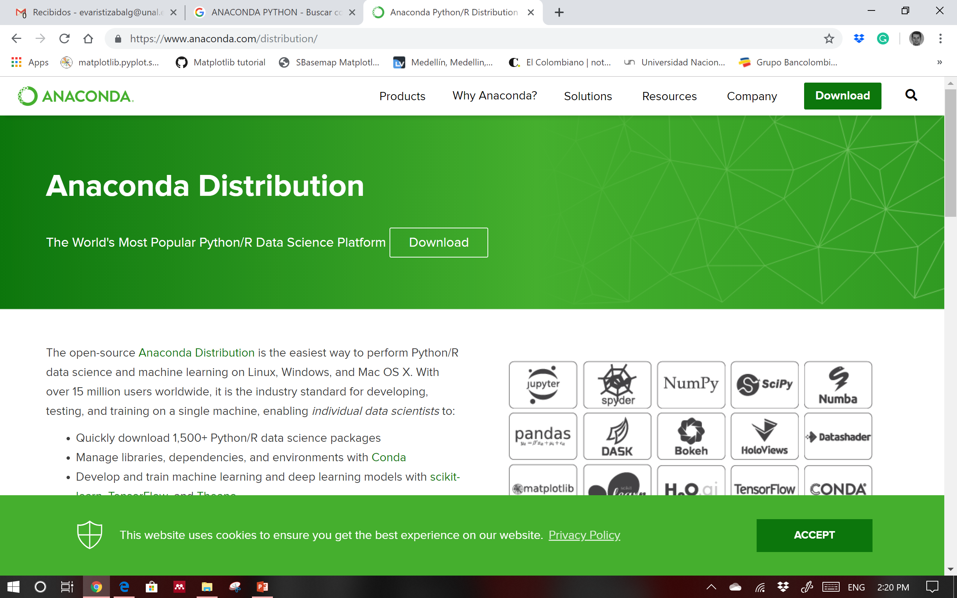
AMBIENTE DE TRABAJO
https://www.anaconda.com/download/

Slide 11
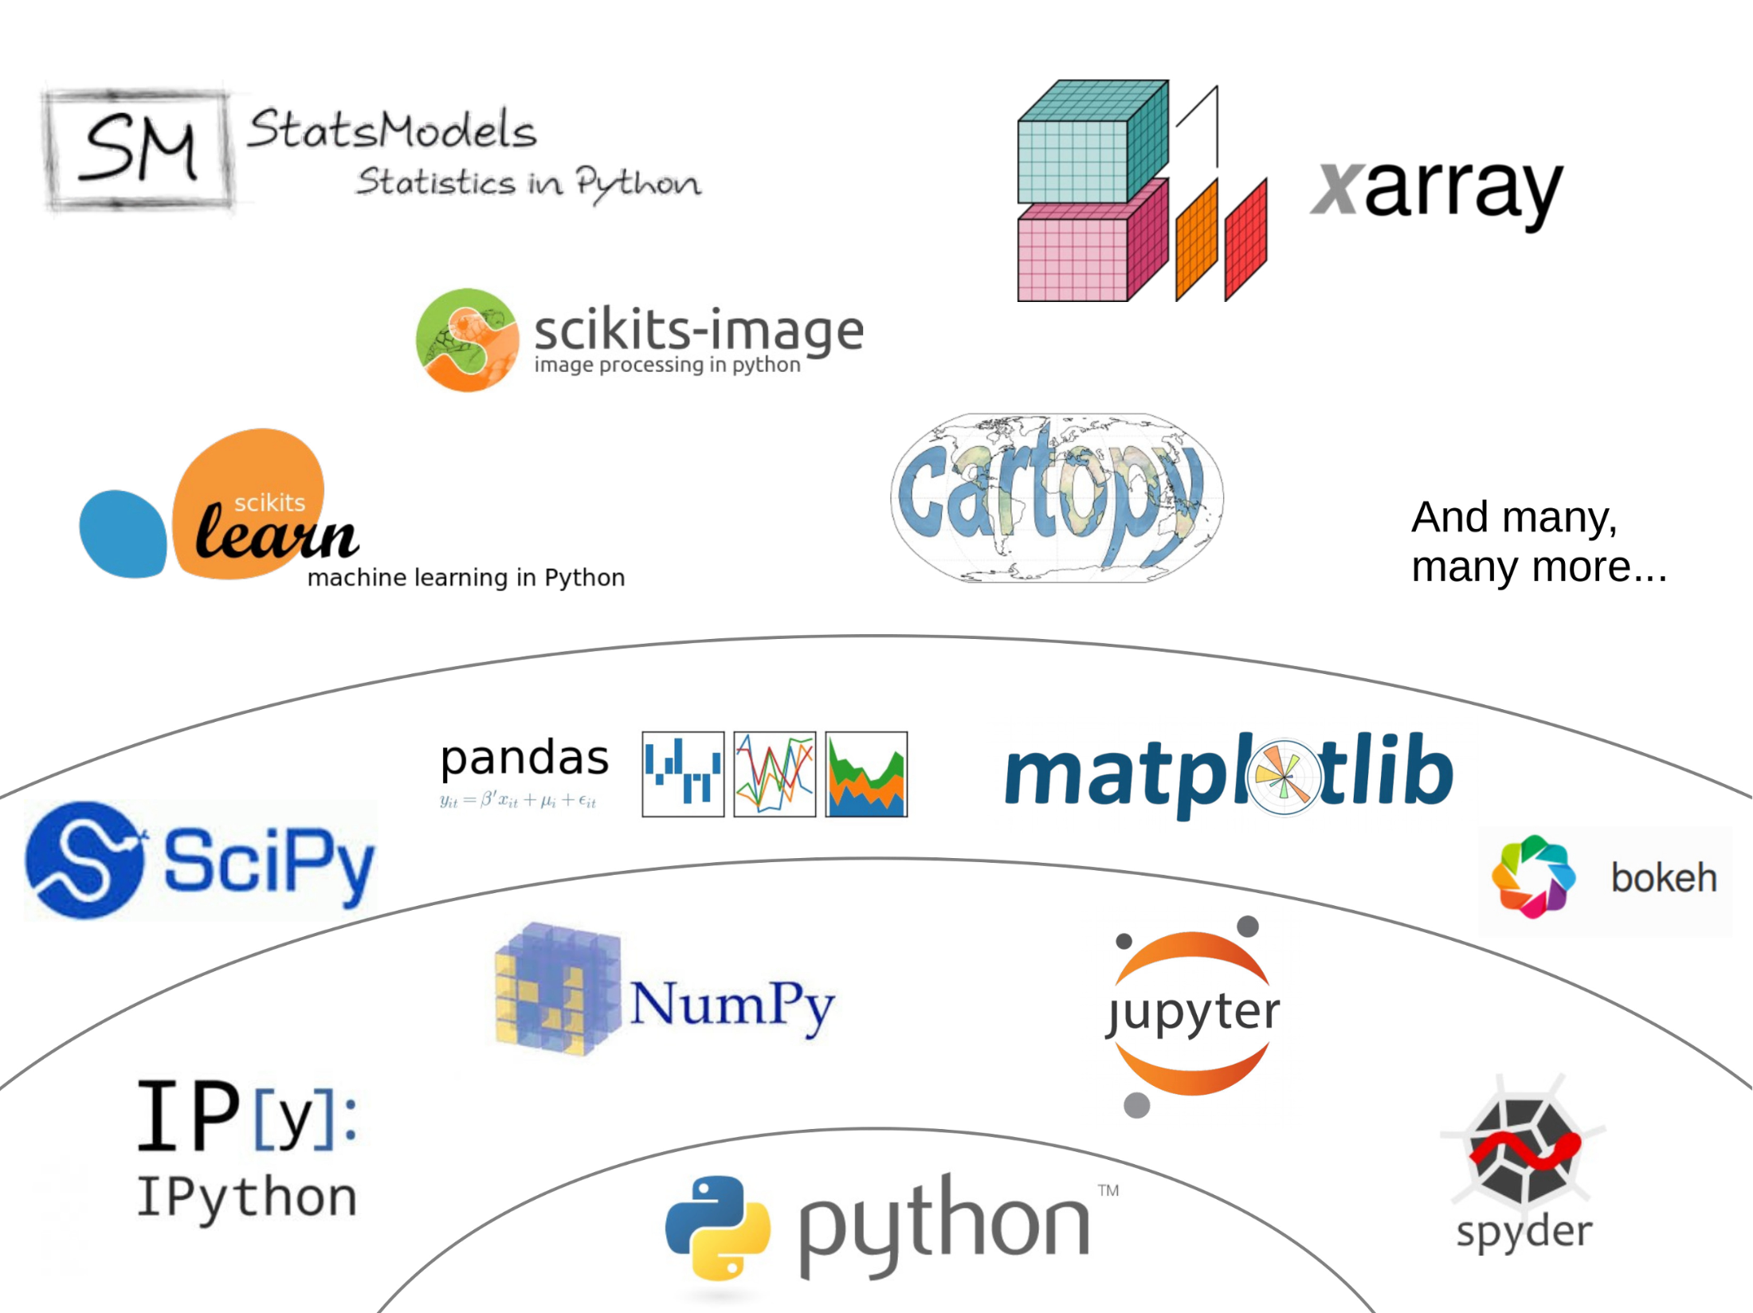

Slide 12
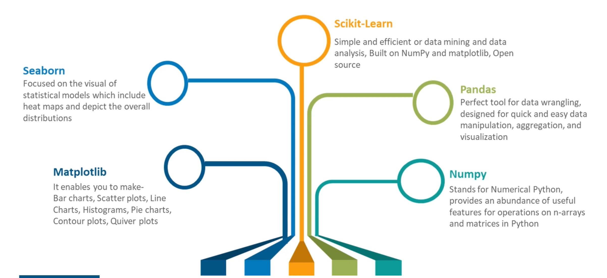
LIBRERIAS A UTILIZAR

Slide 13
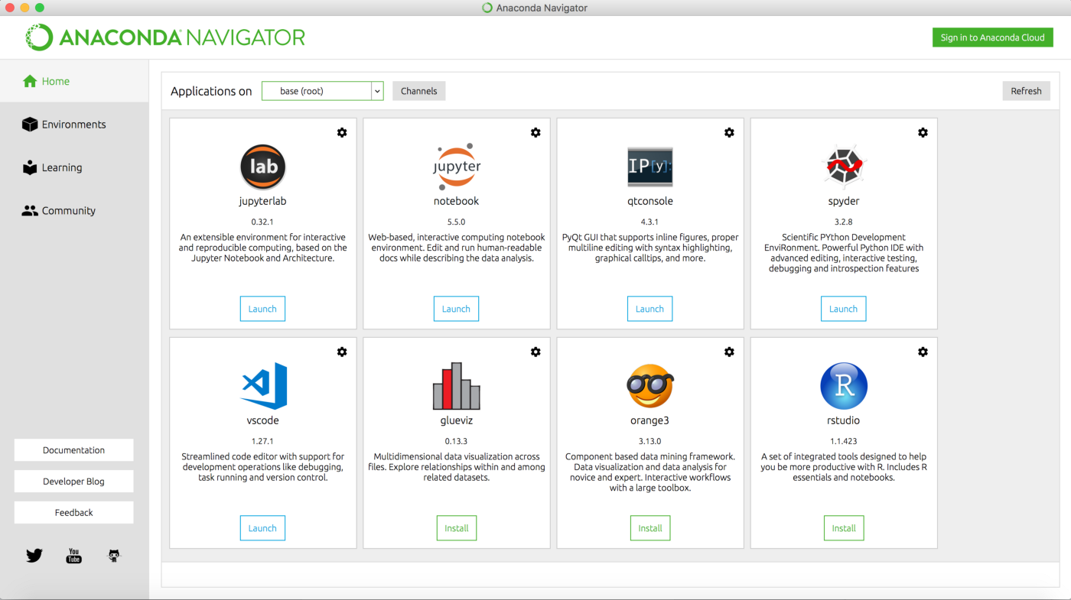

Slide 14
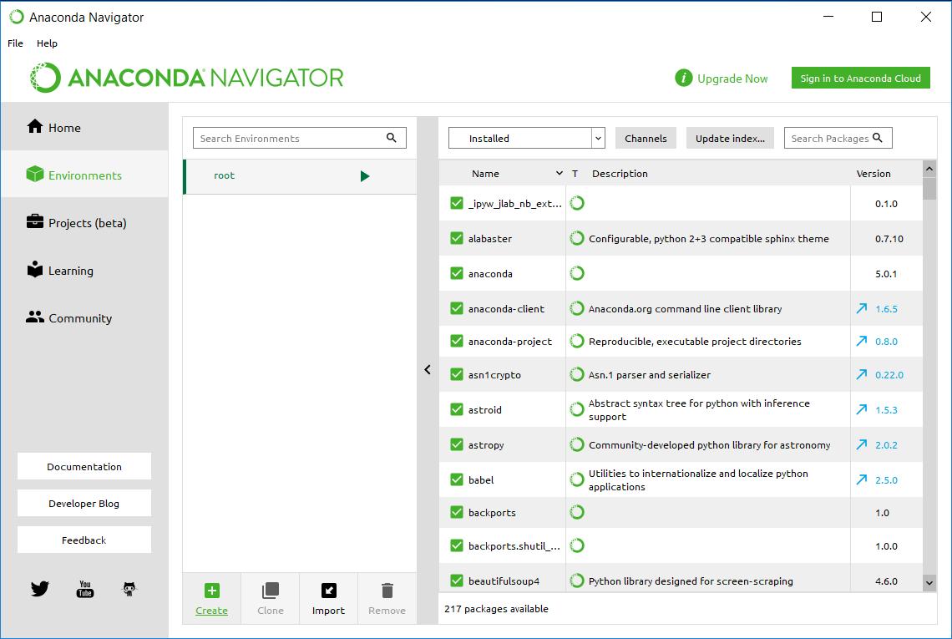
Instalar nuevas librerias → con Anaconda

Slide 15
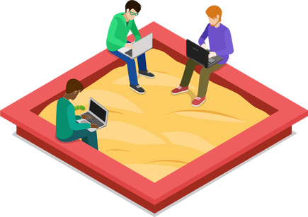
conda install pip
Crear ambientes→ con Anaconda
>> conda create --name your_env_name python=3.7 –y
>> conda info –envs
>> conda activate your_env_name
>> conda deactivate
>> conda install xxxxx
>> conda uninstall xxx
>> conda update xxxxx

Slide 16
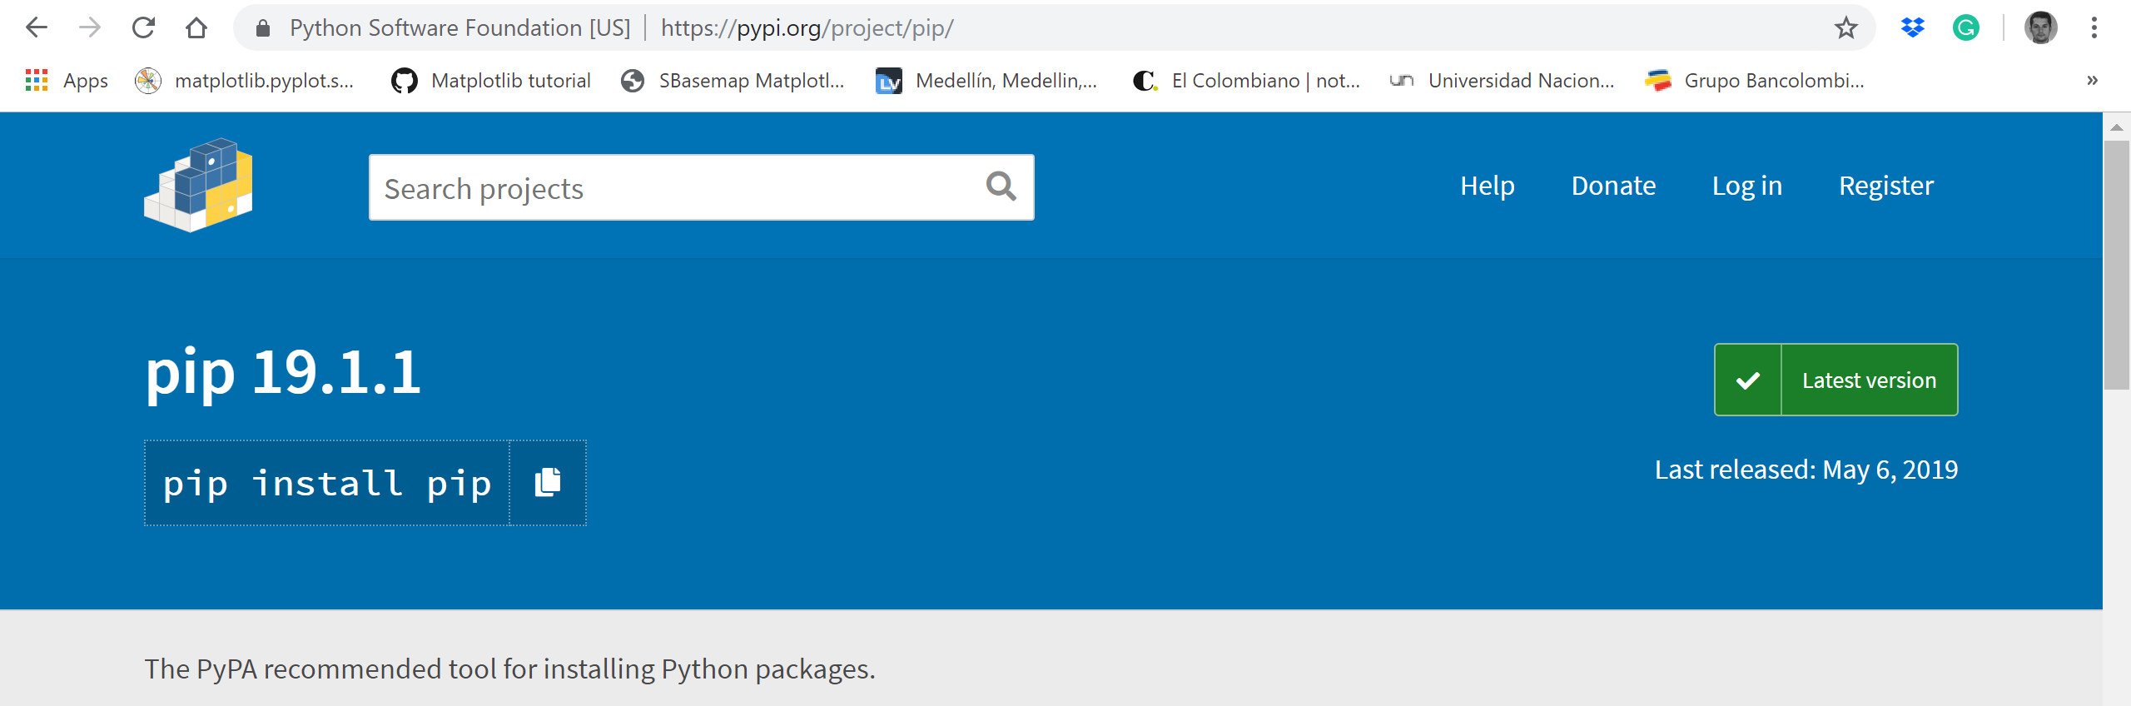
Instalar nuevas librerias → con PIP (Python Packaging Index)
pip install xxxxxxxxx
pip is the package installer for Python. You can use pip to install packages from the Python Package Index and other indexes.
https://pypi.org/project/pip/

Slide 17
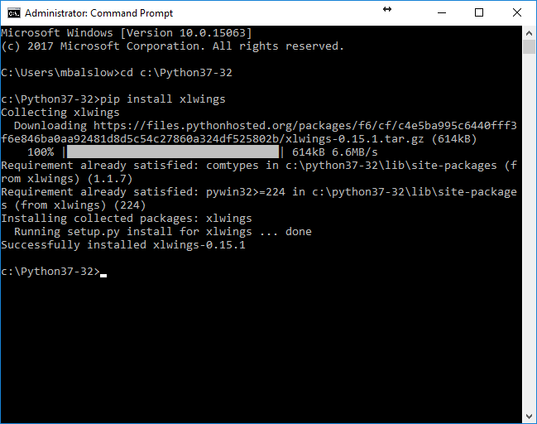

Slide 18
Instalar nuevas librerias → con PIP (Python Packaging Index)
https://pip.pypa.io/en/stable/

Slide 19
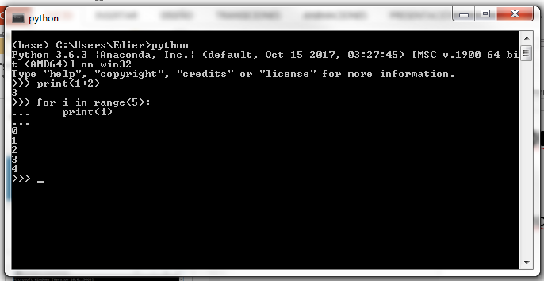
Interpreter /REPL (Read-eval-print loop)

Slide 20
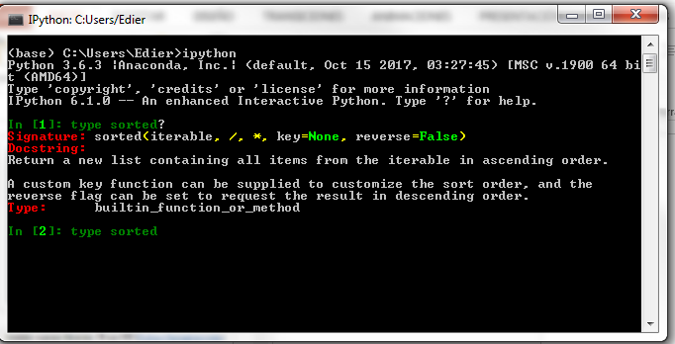
Interpreter /ipython (interactive python)

Slide 21
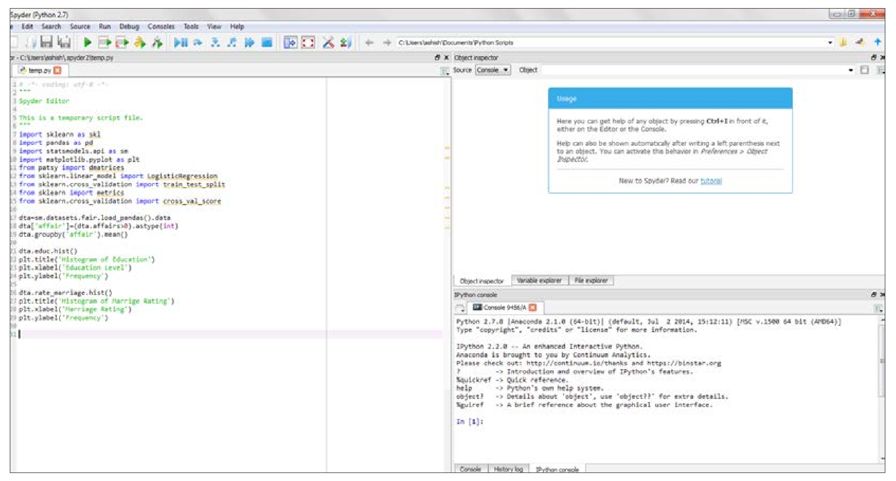
IDEs for Python
Scripts (.py )
Spyder

Slide 22
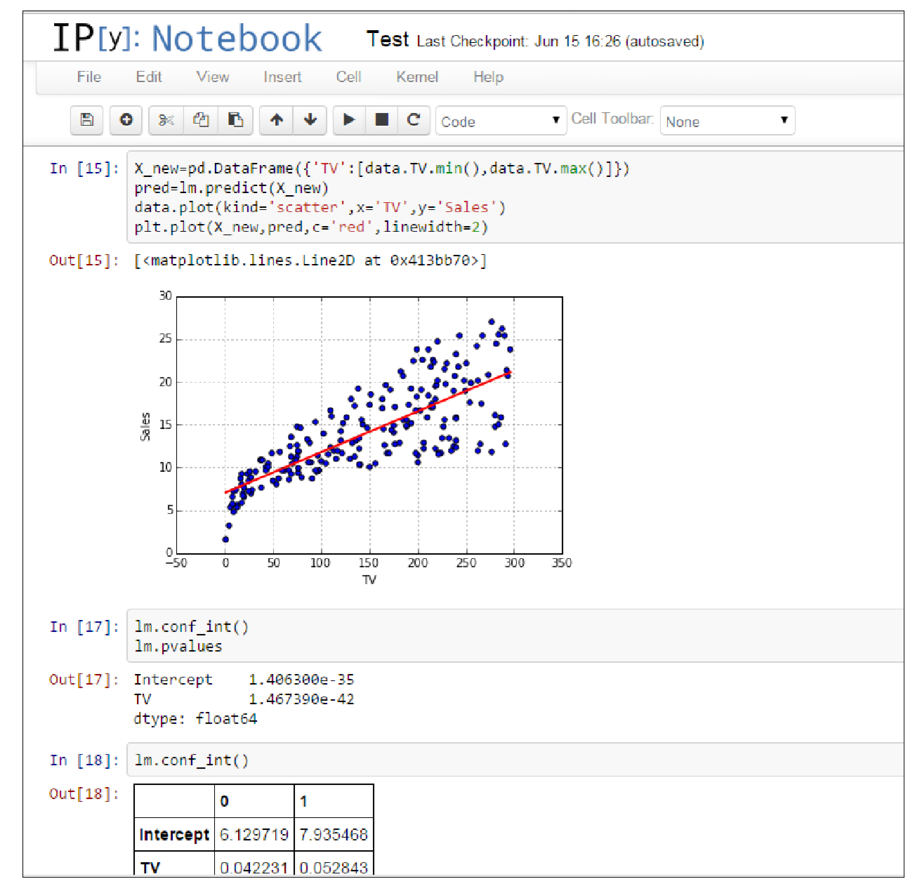
IDEs (Integrated Developer Environments) for Python
Jupiter → IPython Notebook (.ipynb files)
https://www.youtube.com/watch?v=HW29067qVWk

Slide 23
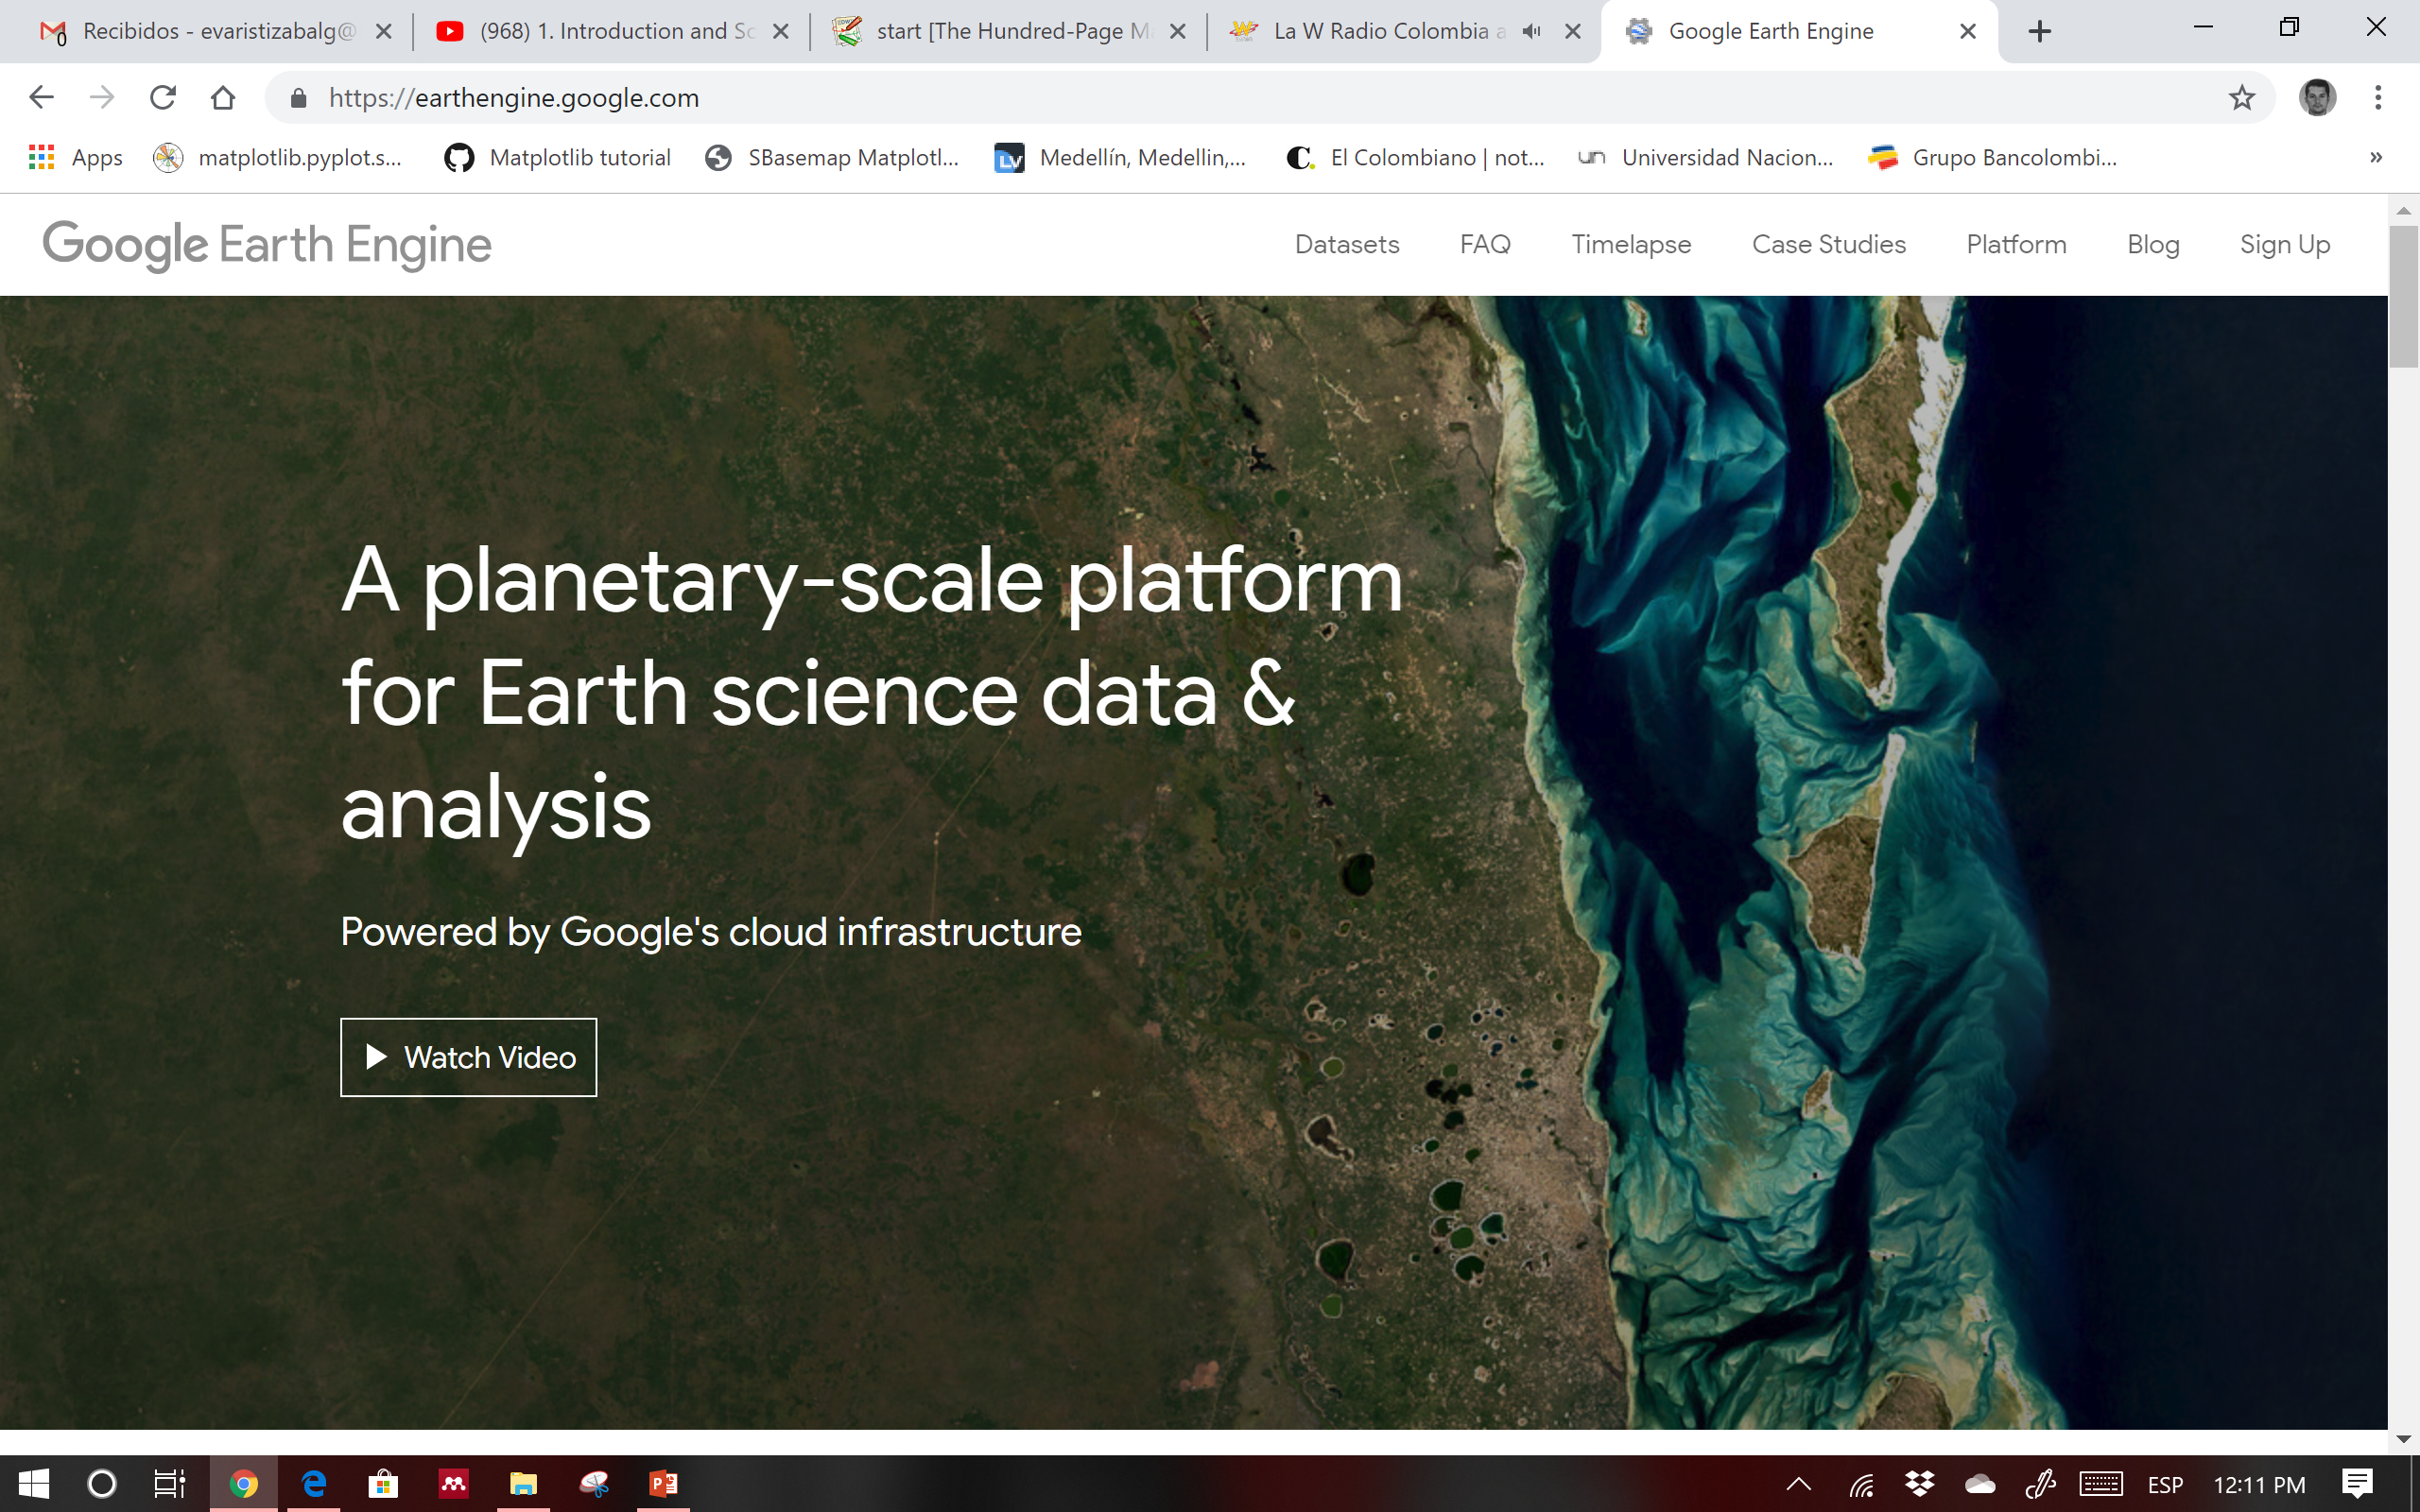
GOOGLE EARTH ENGINE

Slide 24
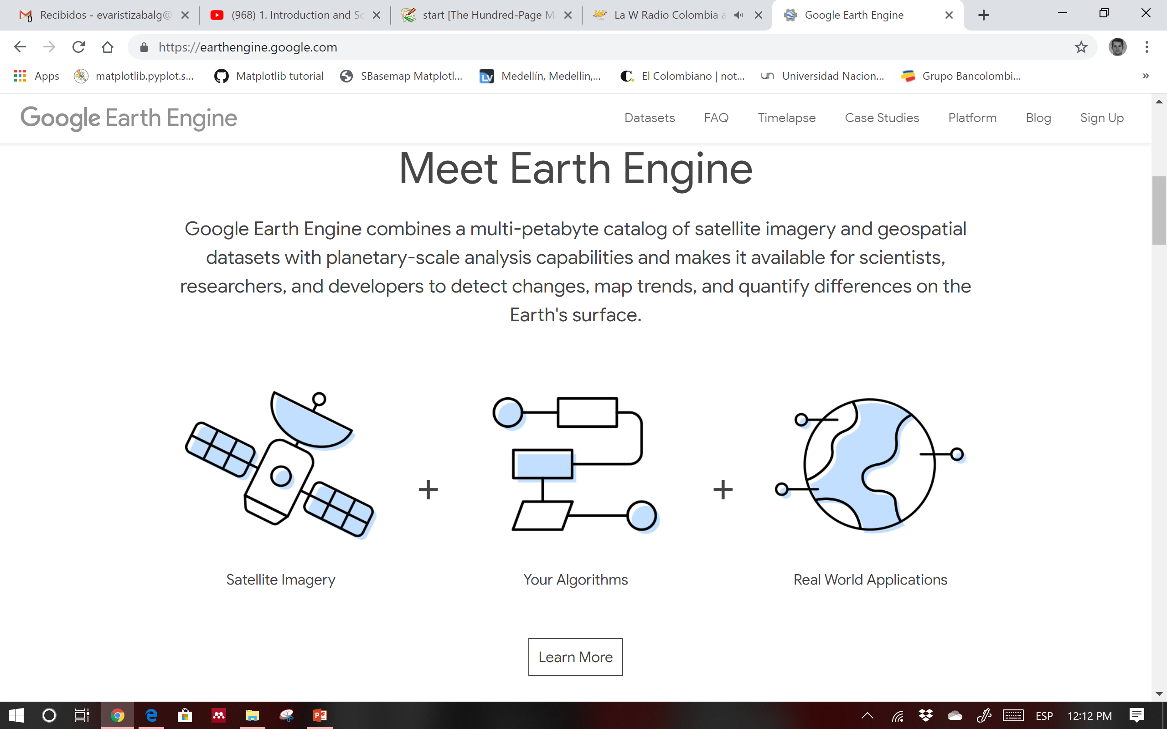
GOOGLE EARTH ENGINE

Slide 25
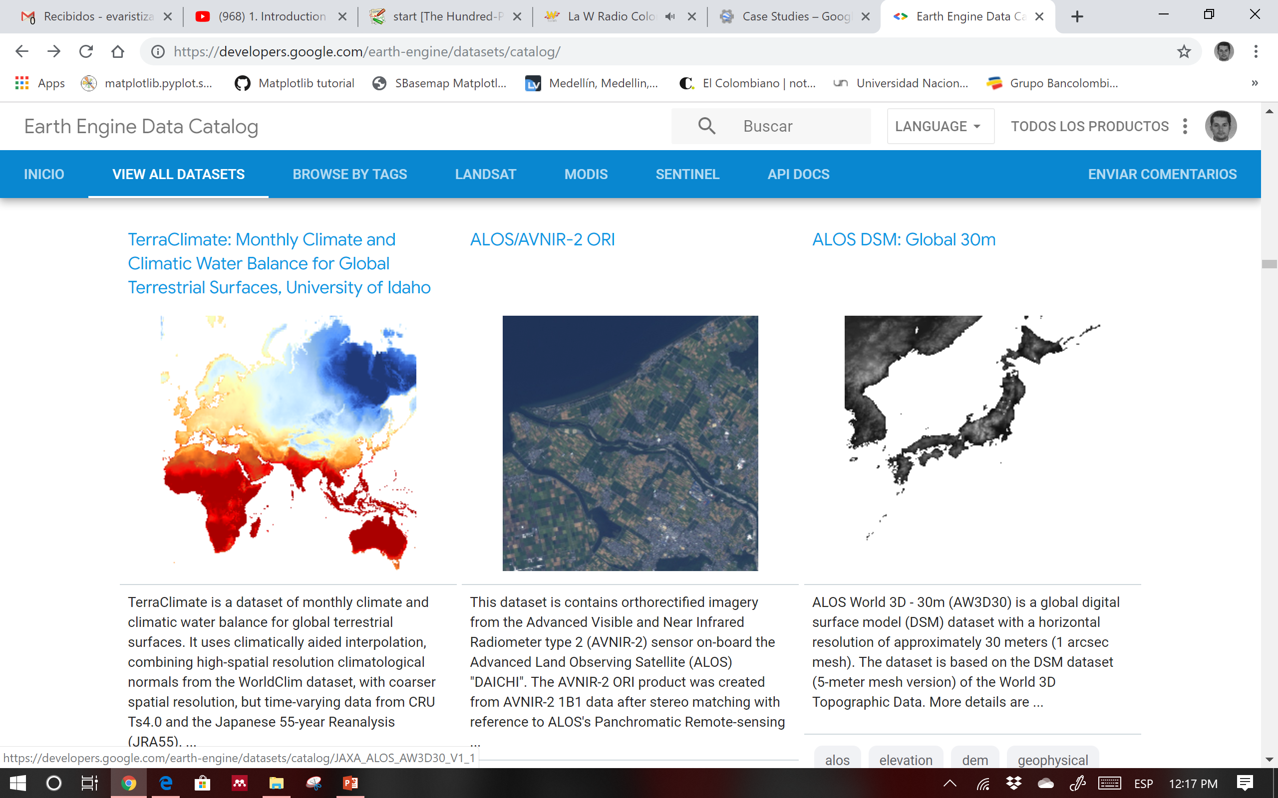
GOOGLE EARTH ENGINE → bases de datos

Slide 26
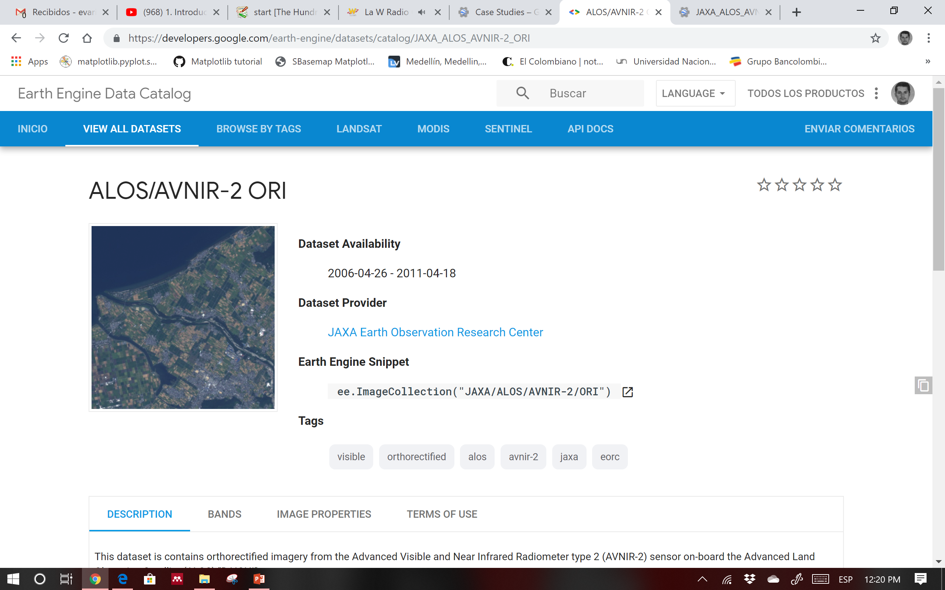
GOOGLE EARTH ENGINE → bases de datos

Slide 27
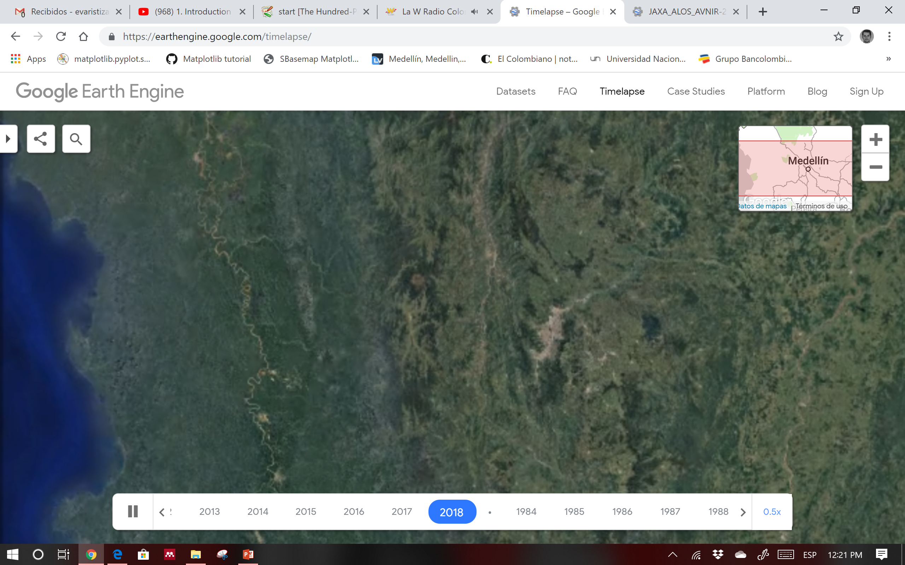
GOOGLE EARTH ENGINE → timelapse

Slide 28
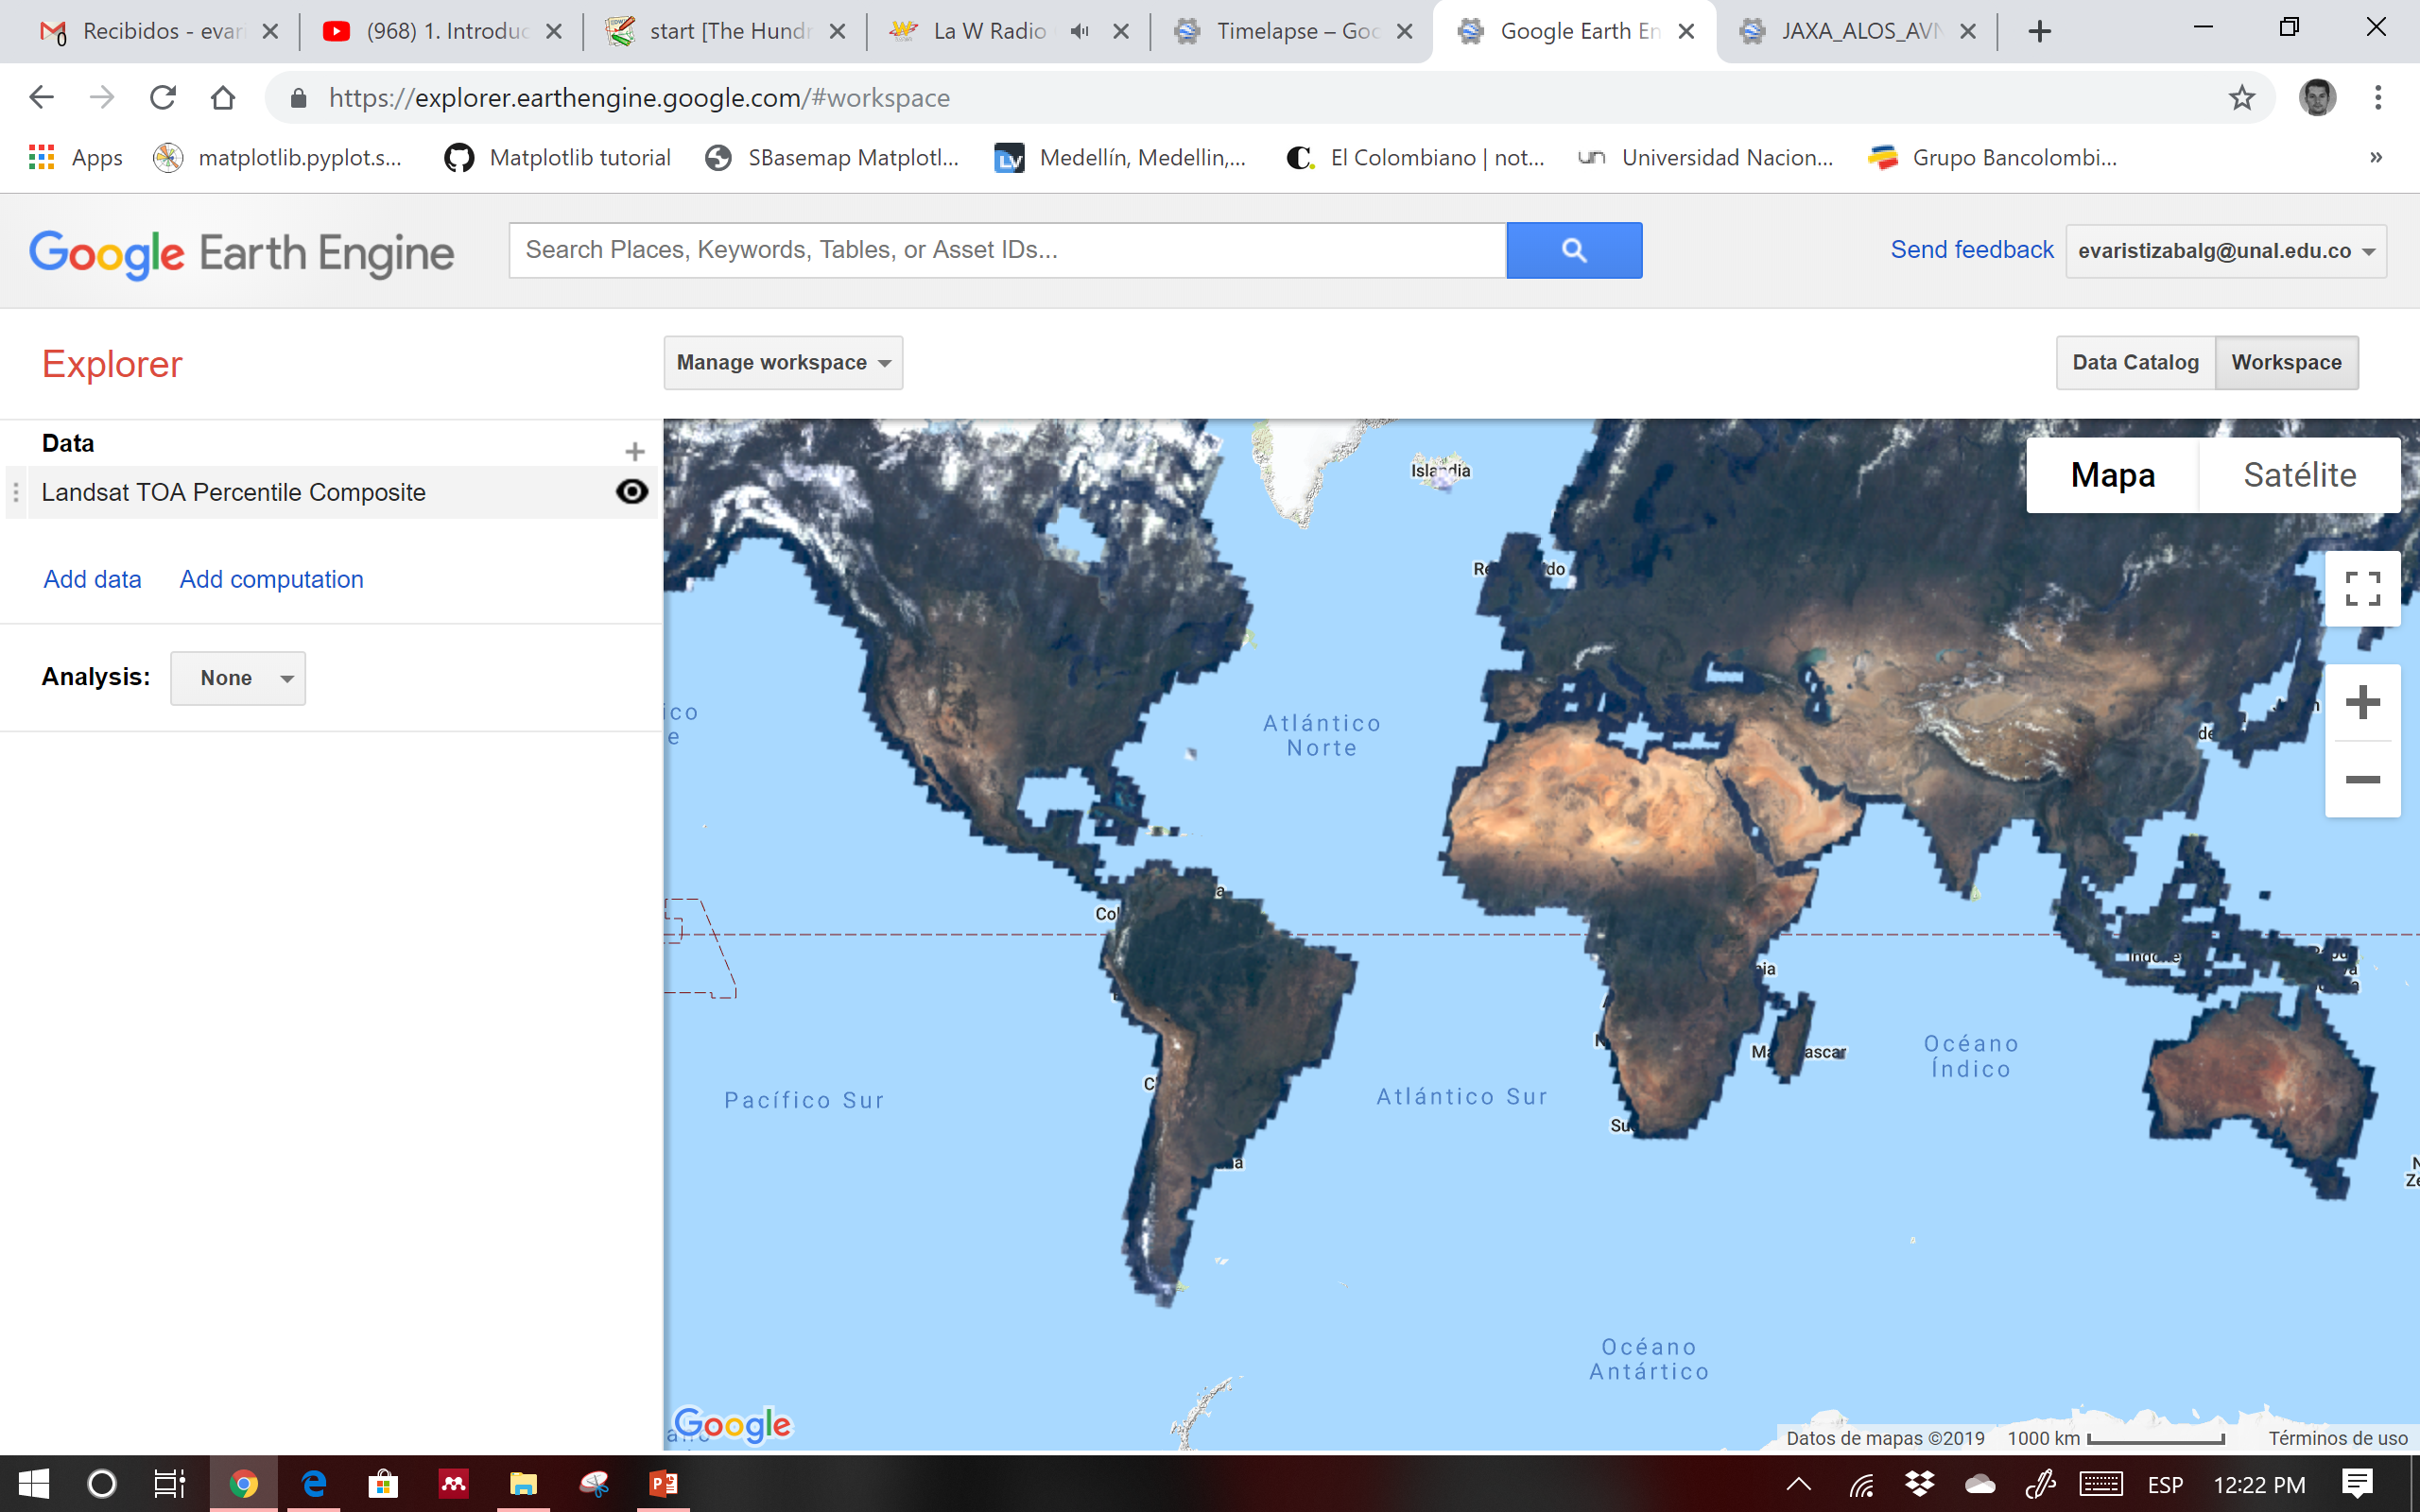
GOOGLE EARTH ENGINE → plataforma

Slide 29
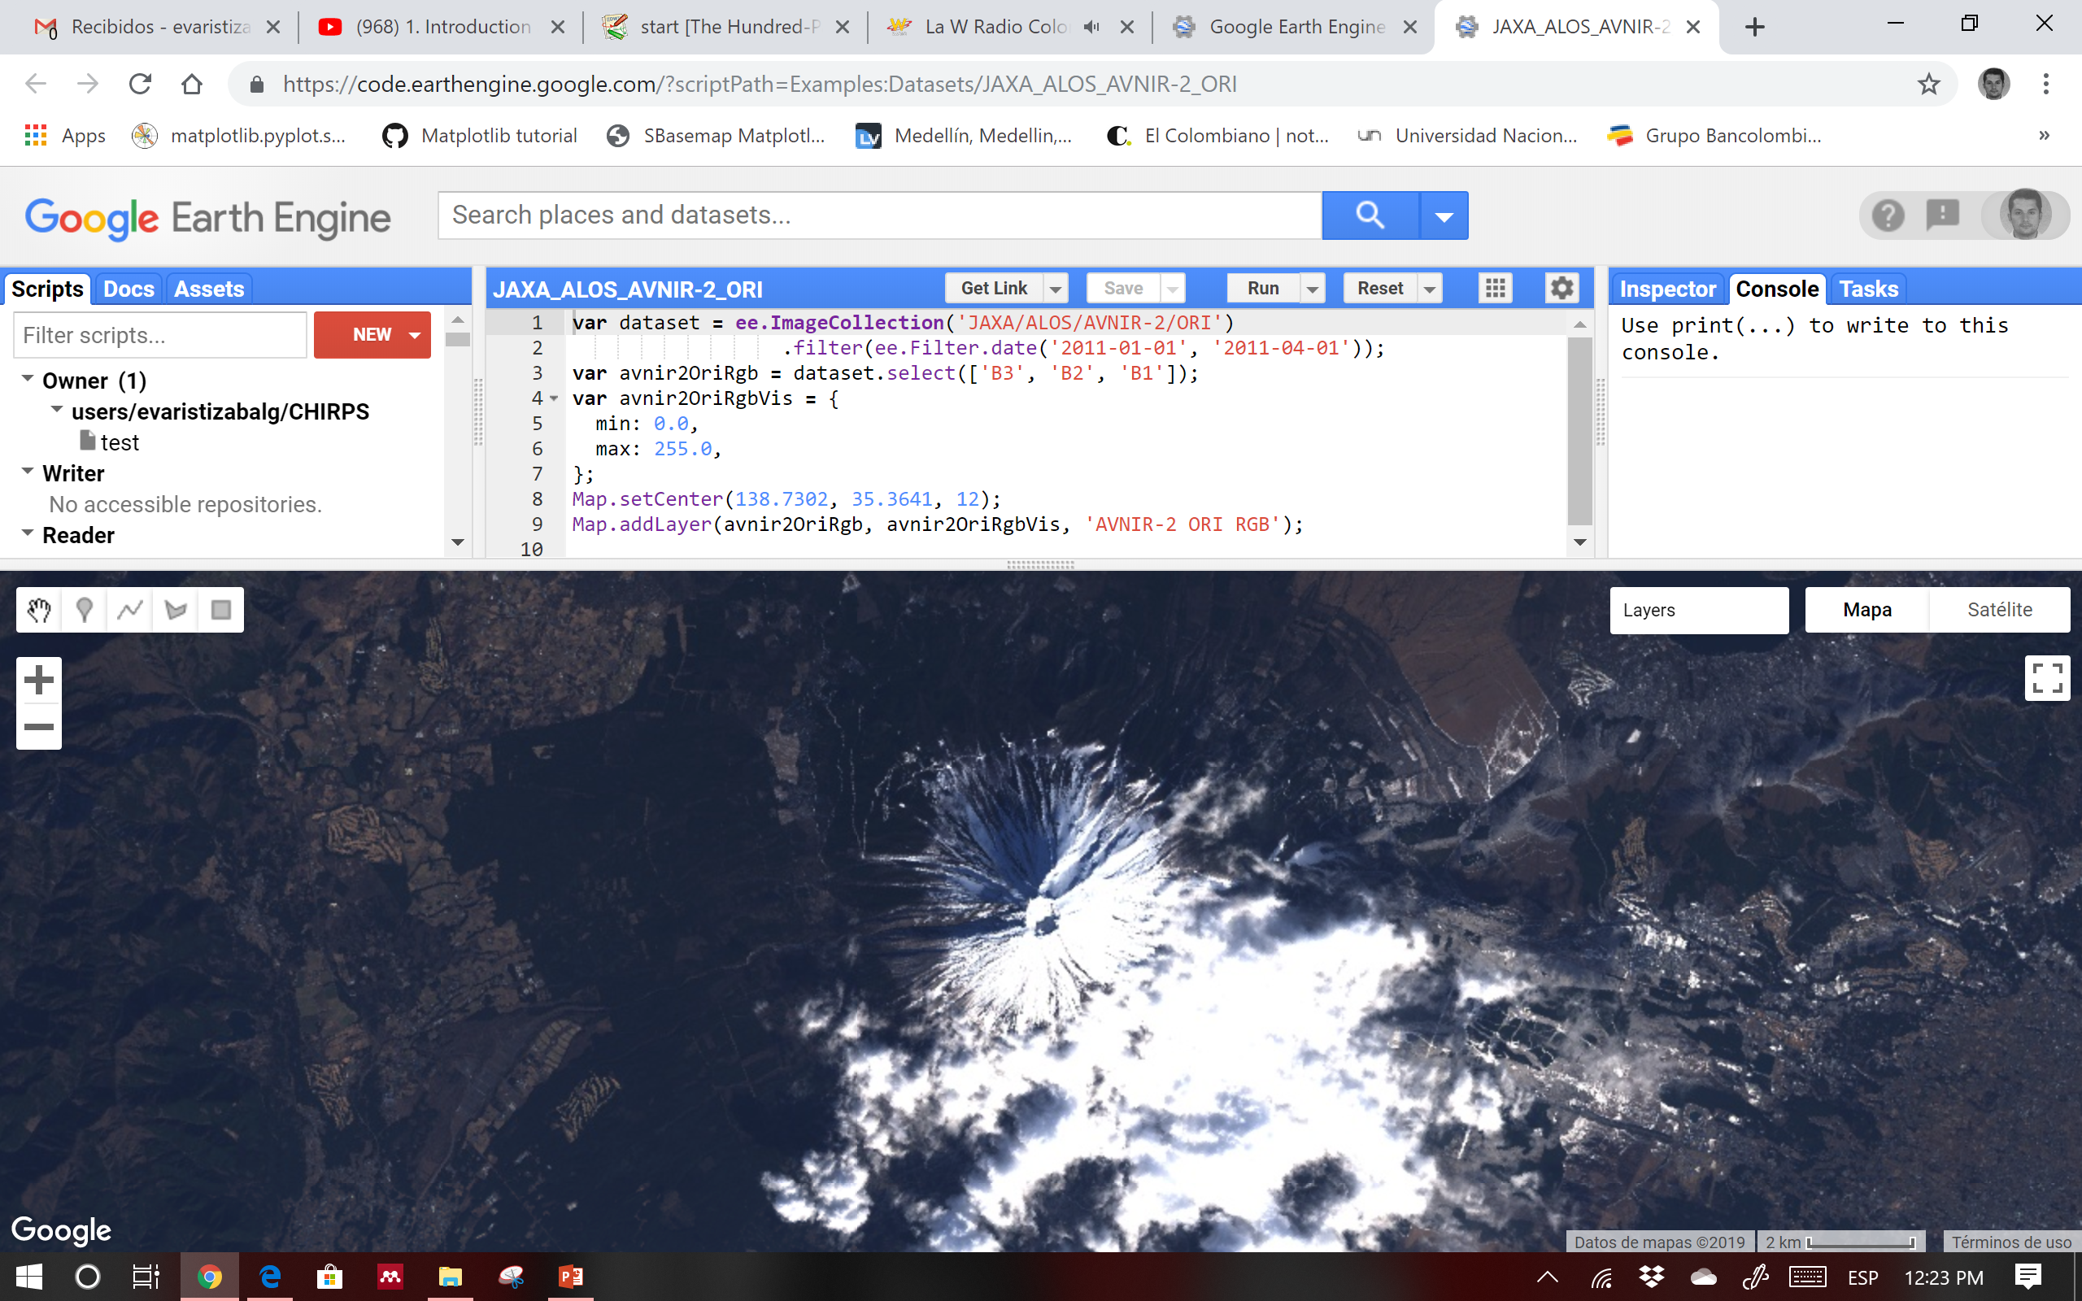
GOOGLE EARTH ENGINE → Código

